Slide 1
Group members ID Jannatun Nayem 1821896642
CSE 499A
TWITTER SENTIMENT ANALYSIS

Slide 2
What is project?
The main goal is to connect on Twitter and search for the tweets that contain a particular keyword and then evaluate the polarity of the tweets as positive, negative or neutral. For accurate and easy method of analysing people view and sentiments we use the twitter sentiment analysis.

Slide 3
Work Flow
1. Keyword-Based Search: Conduct targeted searches for tweets containing a specific keyword, allowing for focused data collection on a particular topic.
2. Sentiment Analysis Algorithms: Implement sentiment analysis algorithms, leveraging natural language processing (NLP) techniques to assess the emotional tone of each tweet.
3. Categorization into Positive, Negative, or Neutral: Classify tweets into three main categories based on sentiment: positive, negative, or neutral, providing a quick overview of public perception.
4. Machine Learning Models: Enhance accuracy by employing machine learning models trained on labeled datasets, enabling precise sentiment classification and pattern recognition.
5. Real-Time Insights: Leverage the immediacy of Twitter to obtain real-time insights into public opinion, enabling organizations to adapt strategies promptly.
6. Strategic Decision-Making: Utilize the sentiment analysis results for informed decision-making, whether in brand management, market research, or understanding societal attitudes toward specific events or issues.

Slide 4
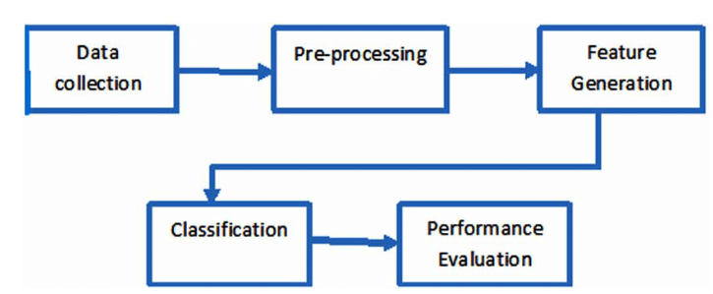
System Design

Slide 5
Project analysis slide 3
Social , Economic, Financial Impact
Economic Impact
Social Impact
FINANCIAL Impact
Companies can refine marketing strategies based on sentiment analysis, enhancing brand perception and market positioning
Provides insights into public opinions, helping society understand prevailing sentiments on various topics and events.
Enables policymakers to gauge public sentiment towards government policies, aiding in responsive governance

Slide 6
Project analysis slide 8
Tools and Technologies
Python:
Used for data cleaning, preprocessing, and analysis.
NLTK (Natural Language Toolkit):
Utilized for tokenization, stemming, and stop word removal.
Scikit-learn:
Implemented machine learning algorithms for sentiment classification.
TensorFlow (or PyTorch):
Deployed deep learning models for advanced sentiment analysis.
Development Environment:
Jupyter Notebooks:
Used for interactive development and analysis.

Slide 7
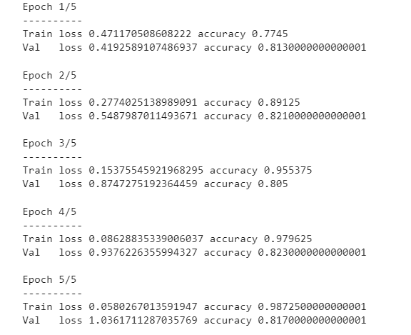
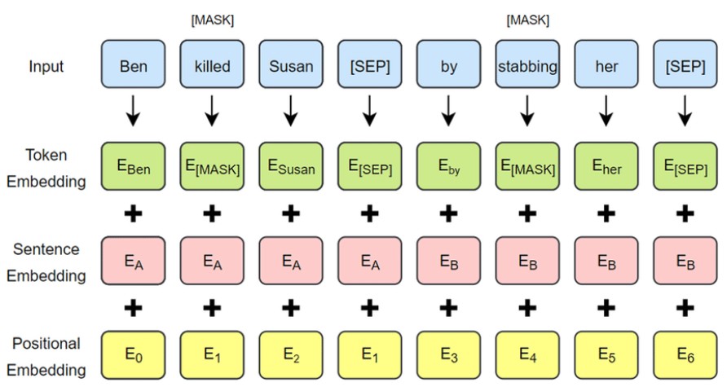
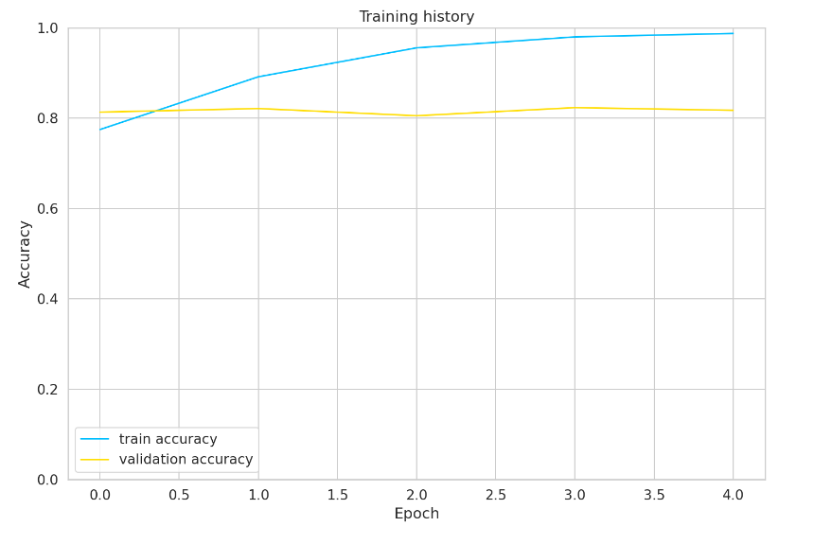
Project analysis slide 6
Results
Sentiment Analysis with 'bert-base-cased' Model
Accuracy: 98.72%
Demonstrates the high precision of the sentiment analysis model.
Validation Score: 81.70%
Reflects the robustness of the model on unseen data.
Bert Architecture

Slide 8
Future Improvements and Advancements
1. Incorporating Transformer Models:
Explore the integration of state-of-the-art transformer models beyond BERT, such as GPT-4 or T5, to harness the latest advancements in language understanding and context modeling.
2. Domain-Specific Fine-Tuning:
Implement fine-tuning strategies on pre-trained models using domain-specific datasets to tailor the sentiment analysis system for industry-specific or niche contexts, ensuring better alignment with our objectives.
3. Continuous Learning Framework:
Develop a continuous learning framework that allows our sentiment analysis model to adapt and evolve over time as language usage and sentiment expressions on Twitter change.
4. Real-Time Feedback Loop:
Establish a real-time feedback loop where user feedback and corrections contribute to model retraining, fostering a dynamic system that continuously improves its accuracy and adapts to changing language trends.

Slide 9
Thank You

